Slide 1
CS35L – Winter 2019
Slide set: | 4.2
Slide topics: | GDB, debugging
Assignment: | 4

Slide 2
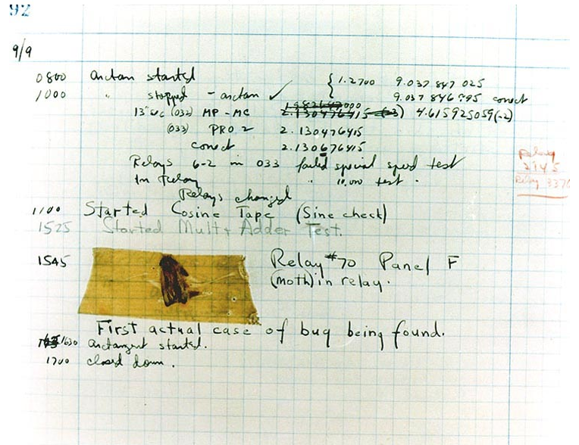
Debugging
Finding and eliminating errors from programs
Grace Hopper and the “First actual case of bug being found”

Slide 3

Debugging Process
Reproduce the bug
Simplify program input
Use a debugger to track down the origin of the problem
Fix the problem

Slide 4
Debugger
A program that is used to run and debug other (target) programs
Advantages:
Programmer can:
step through source code line by line
each line is executed on demand
interact with and inspect program at run-time
If program crashes, the debugger outputs where and why it crashed

Slide 5
GDB – GNU Debugger
Debugger for several languages
C, C++, Java, Objective-C, etc.
Allows you to inspect what the program is doing at a certain point during execution
Logical errors and segmentation faults are easier to ﬁnd with the help of gdb

Slide 6
Using GDB
Compile Program
Normally: $ gcc [flags] <source files> -o <output file>
Debugging: $ gcc [other flags] –g <source files> -o <output file>
enables built-in debugging support
Specify Program to Debug
$ gdb <executable>
or
$ gdb
(gdb) file <executable>

Slide 7
Using GDB
3. Run Program
(gdb) run or
(gdb) run [arguments]
4. In GDB Interactive Shell
Tab to Autocomplete, up-down arrows to recall history
help [command] to get more info about a command
5. Exit the gdb Debugger
(gdb) quit

Slide 8
Run-Time Errors vs Logical Errors
Runtime Error/Segmentation fault
Program received signal SIGSEGV, Segmentation fault. 0x0000000000400524 in function (arr=0x7fffc902a270, r1=2, c1=5, r2=4, c2=6) at file.c:12
Line number where it crashed and parameters to the function that caused the error
Logical Error
Program will run and exit successfully
How do we find bugs?

Slide 9
Setting Breakpoints
Breakpoints
used to stop the running program at a specific point
If the program reaches that location when running, it will pause and prompt you for another command
Example:
(gdb) break file1.c:6
Program will pause when it reaches line 6 of file1.c
(gdb) break my_function
Program will pause at the first line of my_function every time it is called
(gdb) break [position] if expression
Program will pause at specified position only when the expression evaluates to true

Slide 10

Breakpoints
Setting a breakpoint and running the program will stop program where you tell it to
You can set as many breakpoints as you want
(gdb) info breakpoints|break|br|b shows a list of all breakpoints

Slide 11
Deleting, Disabling and Ignoring BPs
(gdb) delete [bp_number | range]
Deletes the specified breakpoint or range of breakpoints
(gdb) disable [ bp_number | range]
Temporarily deactivates a breakpoint or a range of breakpoints
(gdb) enable [ bp_number | range]
Restores disabled breakpoints
If no arguments are provided to the above commands, all breakpoints are affected!!
(gdb) ignore bp_number iterations
Instructs GDB to pass over a breakpoint without stopping a certain number of times.
bp_number: the number of a breakpoint
Iterations: the number of times you want it to be passed over

Slide 12
Displaying Data
Why would we want to interrupt execution?
to see data of interest at run-time:
(gdb) print [/format] expression
Prints the value of the specified expression in the specified format
Formats:
d: Decimal notation (default format for integers)
x: Hexadecimal notation
o: Octal notation
t: Binary notation

Slide 13
Resuming Execution After a Break
When a program stops at a breakpoint
4 possible kinds of gdb operations:
c or continue: debugger will continue executing until next breakpoint
s or step: debugger will continue to next source line
n or next: debugger will continue to next source line in the current (innermost) stack frame
f or finish: debugger will resume execution until the current function returns. Execution stops immediately after the program flow returns to the function's caller
the function's return value and the line containing the next statement are displayed

Slide 14
Watchpoints
Watch/observe changes to variables
(gdb) watch my_var
sets a watchpoint on my_var
the debugger will stop the program when the value of my_var changes
old and new values will be printed
(gdb) rwatch expression
The debugger stops the program whenever the program reads the value of any object involved in the evaluation of expression

Slide 15
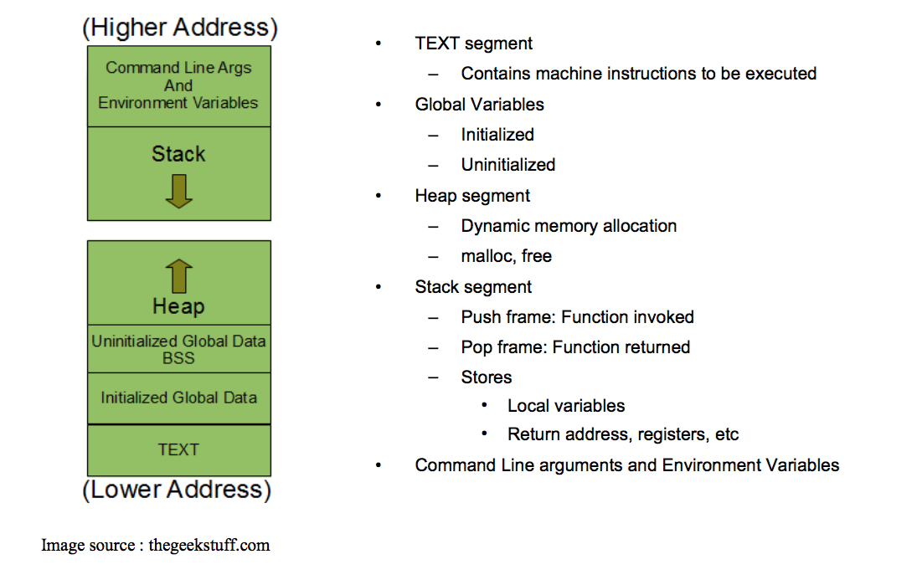
Process Memory Layout

Slide 16
Stack Info
A program is made up of one or more functions which interact by calling each other
Every time a function is called, an area of memory is set aside for it. This area of memory is called a stack frame and holds the following crucial info:
storage space for all the local variables
the memory address to return to when the called function returns
the arguments, or parameters, of the called function
Each function call gets its own stack frame. Collectively, all the stack frames make up the call stack

Slide 17
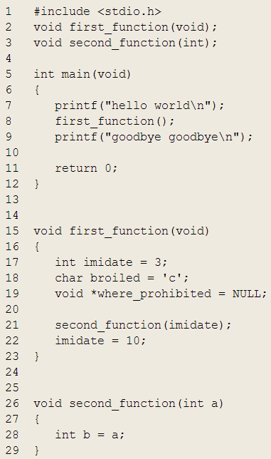
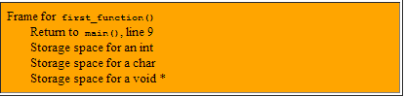

Stack Frames and the Stack
Program Ends
When first_function() returns, its frame is used to determine where to return to (line 9 of main()), then deallocated and returned to the stack
Call to second_function() is made, unused stack memory is used to create a stack frame for second_function(). The frame holds 3 things: storage space for an int and the current address of execution within second_function()
One stack frame belonging to main():
Uninteresting since main() has no automatic variables, no parameters, and no function to return to
Call to first_function() is made, unused stack memory is used to create a frame for first_function(). It holds four things: storage space for an int, a char, and a void *, and the line to return to within main()
When second_function() returns, its frame is used to determine where to return to (line 22 of first_function()), then deallocated and returned to stack.
When main() returns, the program ends

Slide 18
Analyzing the Stack in GDB
(gdb) backtrace|bt
Shows the call trace (the call stack)
Without function calls:
#0 main () at program.c:10
one frame on the stack, numbered 0, and it belongs to main()
After call to function display()
#0 display (z=5, zptr=0xbffffb34) at program.c:15
#1 0x08048455 in main () at program.c:10
Two stack frames: frame 1 belonging to main() and frame 0 belonging to display().
Each frame listing gives
the arguments to that function
the line number that's currently being executed within that frame

Slide 19
Analyzing the Stack
(gdb) info frame
Displays information about the current stack frame, including its return address and saved register values
(gdb) info locals
Lists the local variables of the function corresponding to the stack frame, with their current values
(gdb) info args
List the argument values of the corresponding function call

Slide 20
Other Useful Commands
(gdb) info functions
Lists all functions in the program
(gdb) list
Lists source code lines around the current line

Slide 21
Lab 4
Download old version of coreutils with buggy ls program
Untar, configure, make
Bug: ls -t mishandles files whose time stamps are very far in the past. It seems to act as if they are in the future
$ tmp=$(mktemp -d)
$ cd $tmp
$ touch -d '1918-11-11 11:00 GMT' wwi-armistice
$ touch now
$ sleep 1
$ touch now1
$ TZ=UTC0 ls -lt --full-time wwi-armistice now now1
-rw-r--r-- 1 eggert csfac 0 1918-11-11 11:00:00.000000000 +0000 wwi-armistice
-rw-r--r-- 1 eggert csfac 0 2017-01-25 00:11:55.528846902 +0000 now1
-rw-r--r-- 1 eggert csfac 0 2017-01-25 00:11:54.524820127 +0000 now
$ cd
$ rm -fr $tmp

Slide 22
Goal: Fix the Bug
Reproduce the Bug
Follow steps on lab web page
Simplify input
Run ls with –l and –t options only
Debug
Use gdb to figure out what’s wrong
$ gdb ./ls
(gdb) run –lt /tmp/wwi-armistice /tmp/now /tmp/now1
(run from the directory where the compiled ls lives)
Patch
Construct a patch “lab4.diff” containing your fix
It should contain a ChangeLog entry followed by the output of diff -u

Slide 23
Lab Hints
Don’t forget to answer all questions! (lab4.txt)
Make sure not to submit a reverse patch! (lab4.diff)
“Try to reproduce the problem in your home directory, instead of the $tmp directory. How well does SEASnet do?”
Timestamps represented as seconds since Unix Epoch
SEASnet NFS filesystem has unsigned 32-bit time stamps
Local File System on Linux server has signed 32-bit time stamps
If you touch the files on the NFS filesystem it will return timestamp around 2054
=> files have to be touched on local filesystem (df –l)
Use “info functions” to look for relevant starting point

